Slide 1
MISSION TO BRAZIL’S NORTHEAST
“SERTÃO NORDESTINO”
(“Wilderness of the Northeast”)
By Kamyla de Lellis

Slide 2
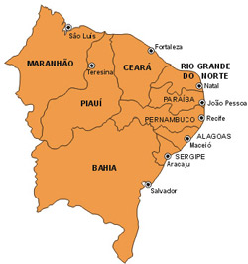
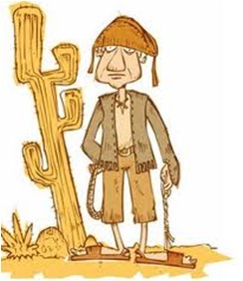
BRAZIL’S NORTHEAST
9 STATES
“SERTÃO NORDESTINO”

Slide 3
There are two very different realities in Brazil’s Northeast---known in Portuguese as the:
“SERTÃO NORDESTINO”

Slide 4
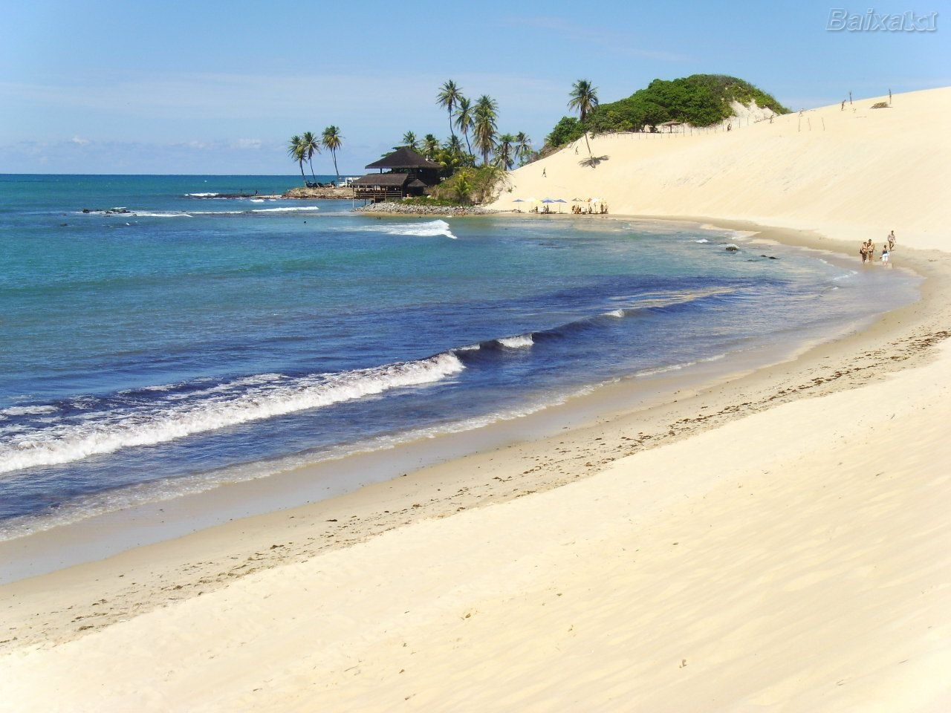
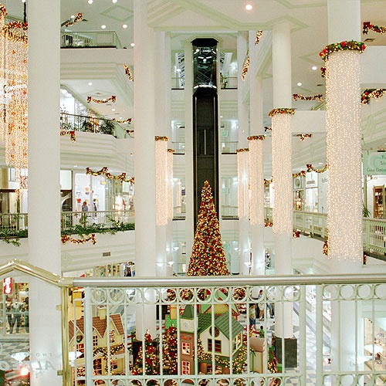
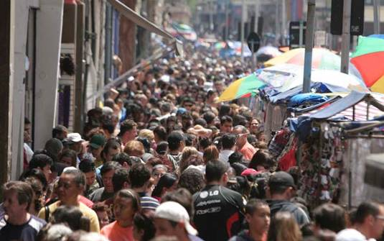
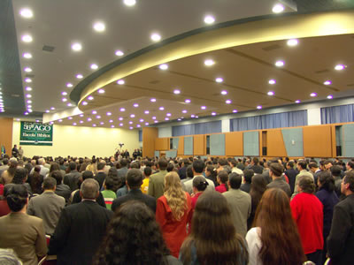
First...
Beautiful beaches there with warm water
Crowded malls
Bustling trade

Slide 5
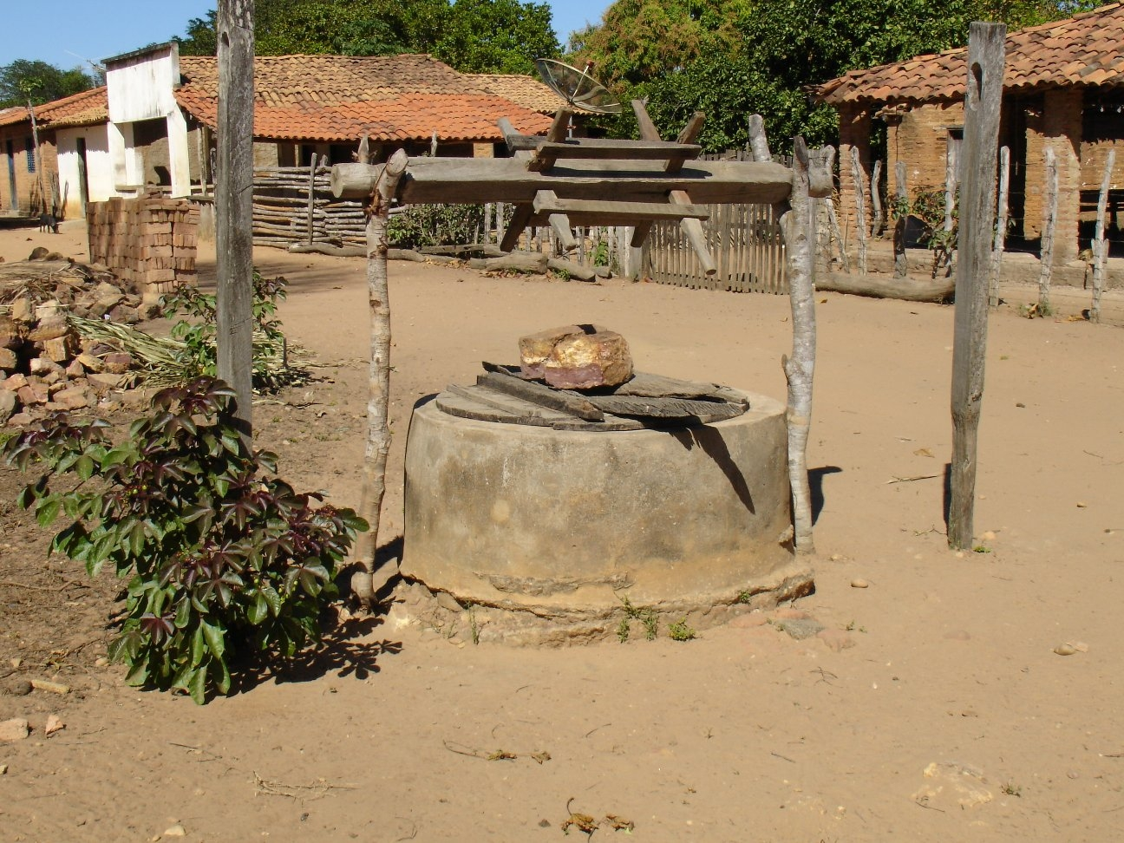
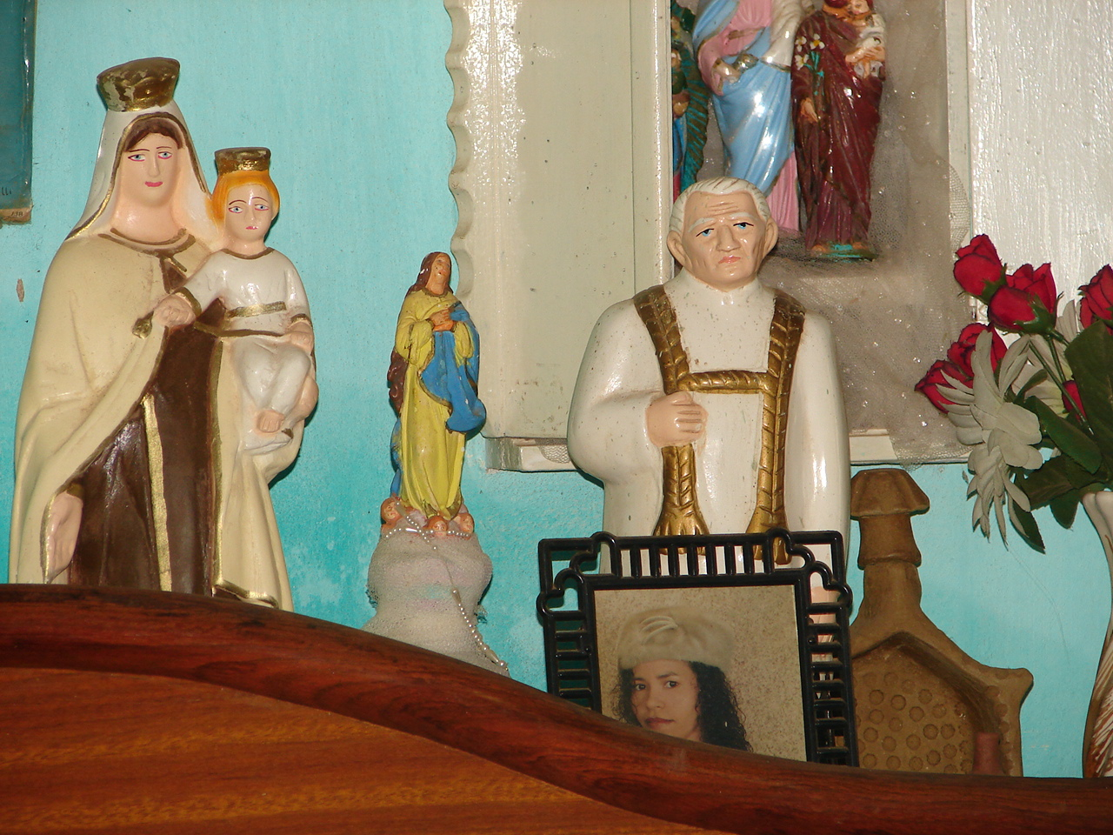
But also...
The overwhelming prevalence of traditional Roman Catholicism mixed with extreme idolatry:
This is the Sertão Nordestino.

Slide 6
It is a rich land…
...with very poor people

Slide 7
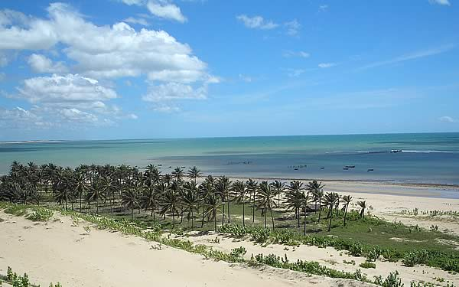
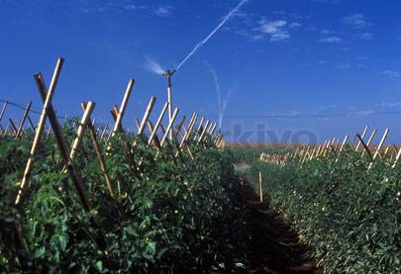
One of the sunniest regions on earth…
In irrigated areas there can be 3 harvests each year
Over 8 hours of sunshine every day on the average

Slide 8
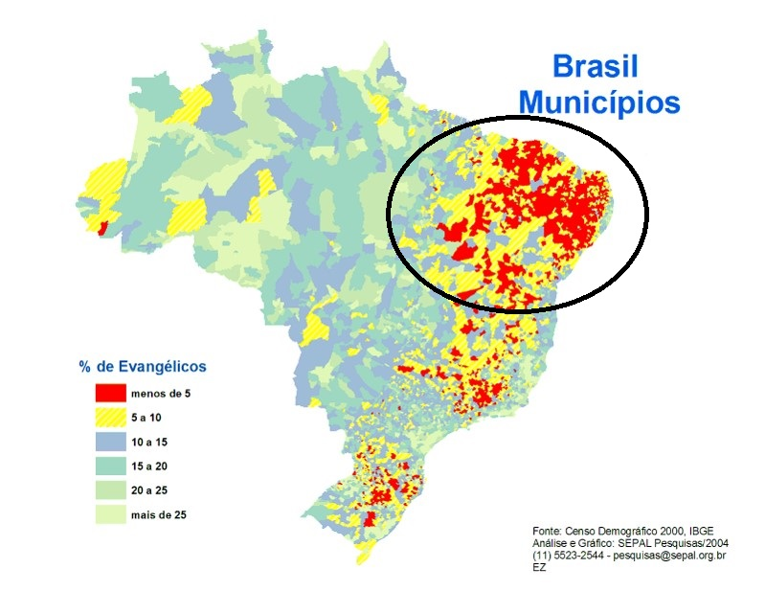
THE SERTÃO NORDESTINO
…the Northeast is the least evangelized region of Brazil with the red areas less than 5% evangelical

Slide 9
The “Sertão Nordestino”
is the biggest missionary challenge in Brazil

Slide 10
In the Sertão Nordestino...
You will find 71% of the least evangelized cities of Brazil

Slide 11
Of the 485 cities in Brazil with less than 3% evangelicals, 343 of them are located in the Sertão Nordestino

Slide 12
The Sertão
It is the border nearest and more neglected Brazilian church.

Slide 13
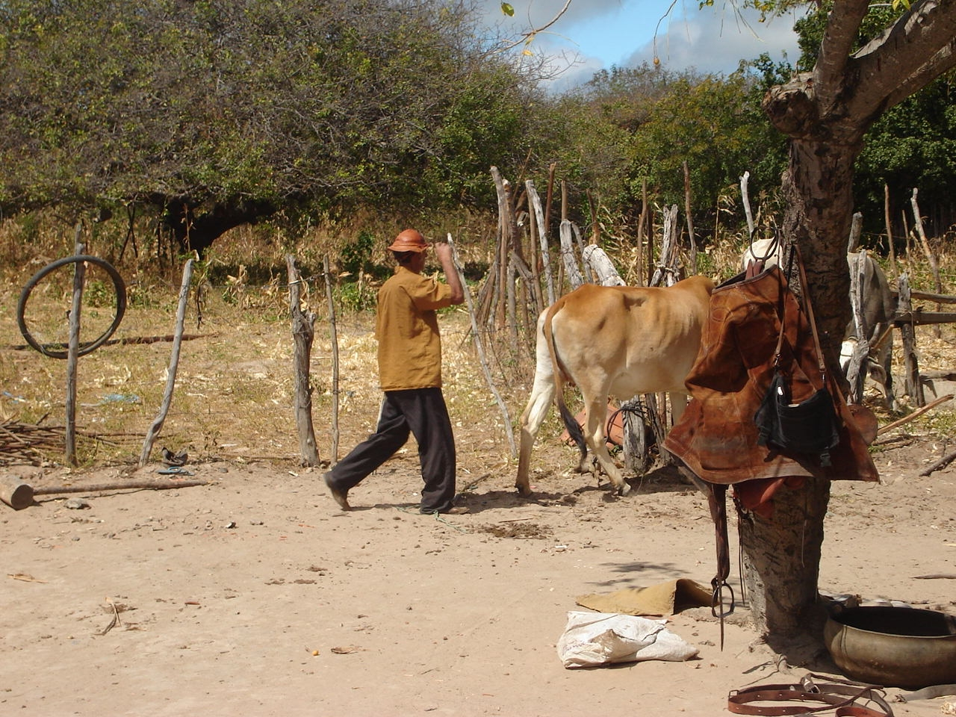
“World evangelization must pass through & include the Sertão”

Slide 14
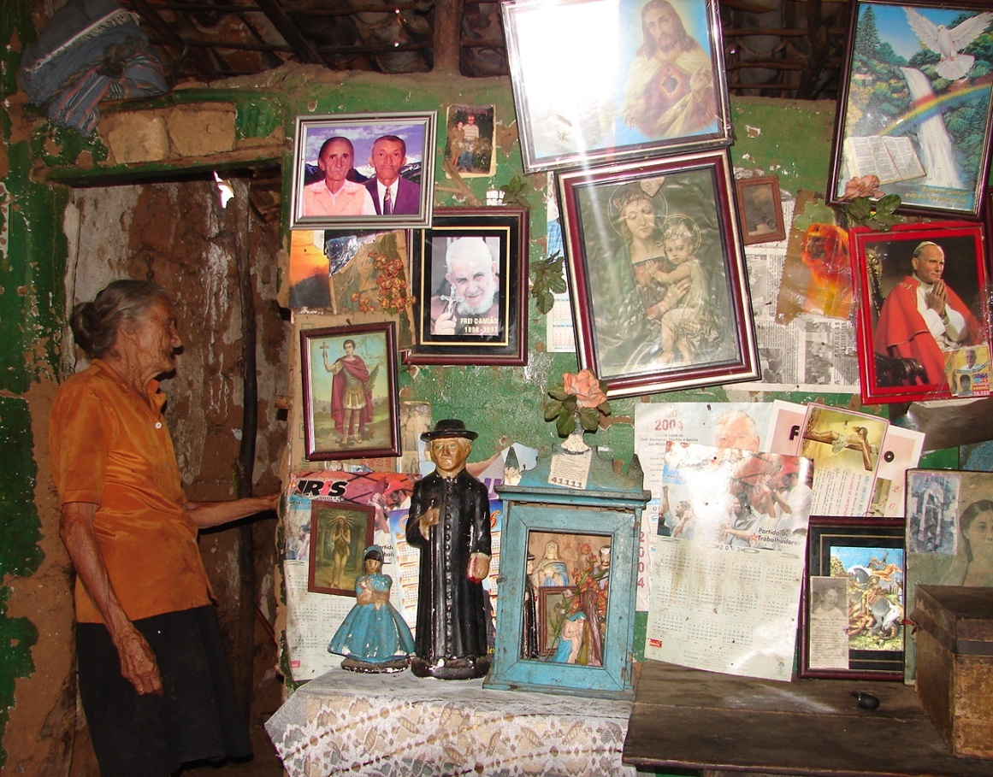
Roman Catholicism in the Sertão
Belief in deities like “Frei Damiao” and “Padre Cicero” is embedded in the culture, shrouding the Northeast
in darkness

Slide 15
Thousands of rural communities in the Sertão, inhabited by over 12 million people, have never had an opportunity to hear the Gospel.

Slide 16
In some places the rates are as alarming as they are in gospel-resistant countries elsewhere in the world… where it is forbidden to preach the gospel.

Slide 17
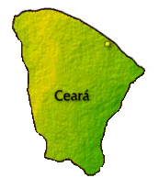
For example, the Northeastern state of Ceará

Slide 18
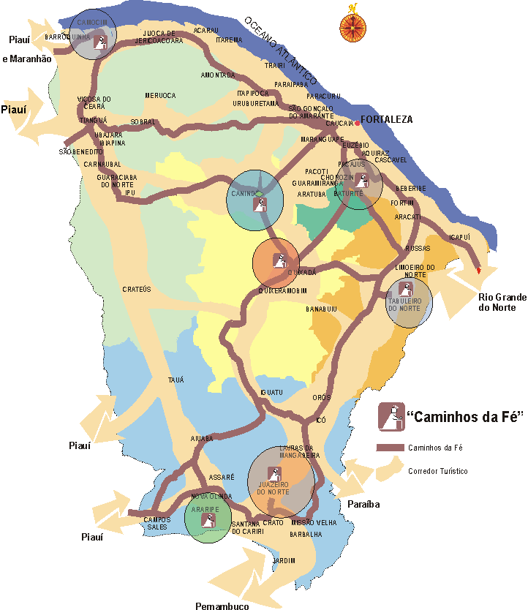
CEARÁ HAS 184 MUNICIPALITIES
8,185,286 inhabitants
Seven cities enslaved by deep idolatry:
JUAZEIRO DO NORTE
ARARIPE
CANINDÉ
BATURITÉ
TABULEIRO DO NORTE
QUIXADÁ
BARROQUINHA
These SEVEN CENTERS of idolatry form the number “7” over Ceará

Slide 19
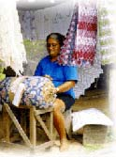
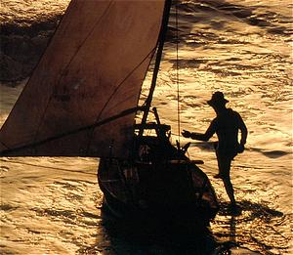
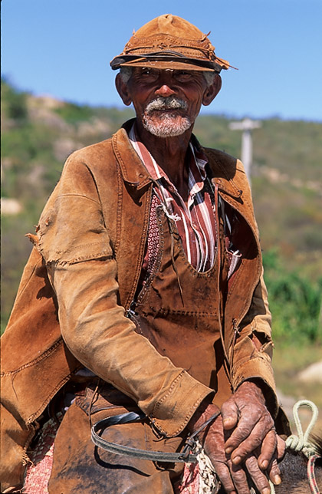
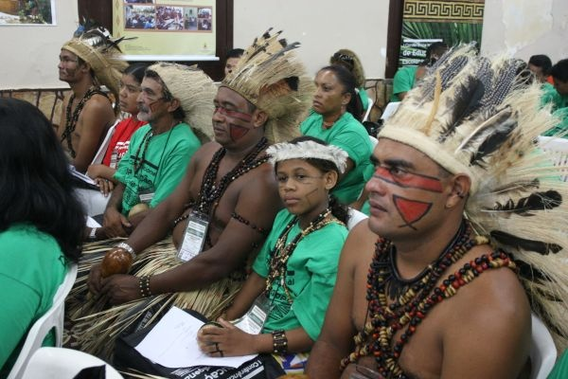
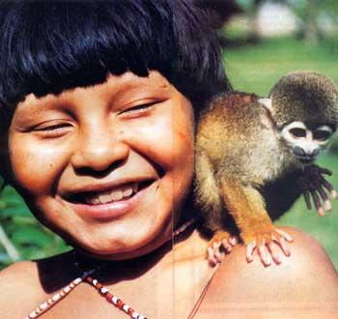
The total population of Ceara is 8,185,286
7,203,052
remain to be evangelized

Slide 20
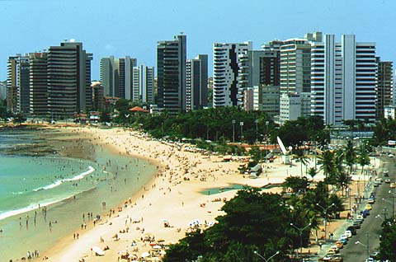
97% of all evangelicals in Ceará live in one city: Fortaleza on the coast

Slide 21
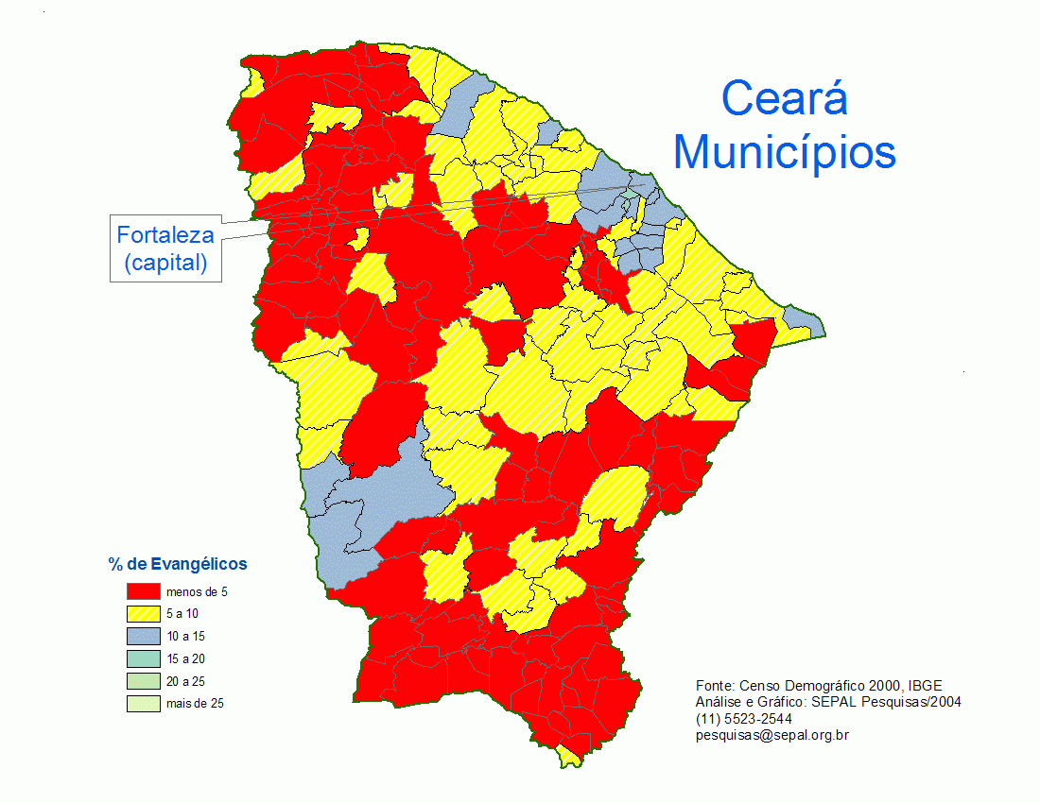
The remaining 3% of evangelicals are scattered in other municipalities
Red means less than 5% evangelicals while grey means 5 to 10% evangelical
Notes:
Existem vários municípios com menos de 10% de evangélicos na sua população (em amarelo) e vários com menos de 5% (em vermelho).
Esses municípios devem ter a atenção da Igreja Evangélica no Brasil.

Slide 22
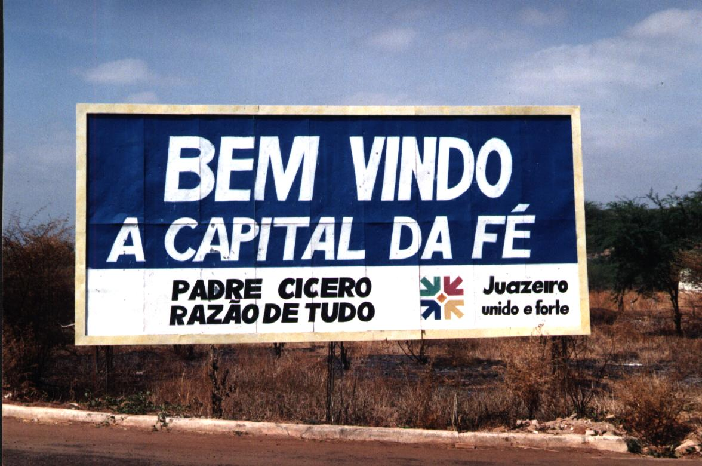
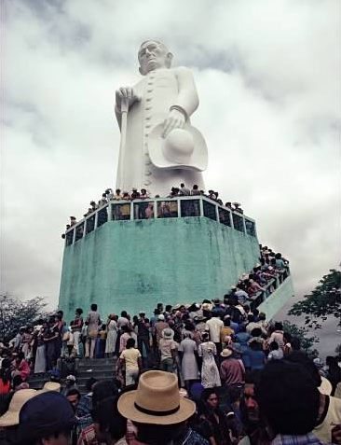
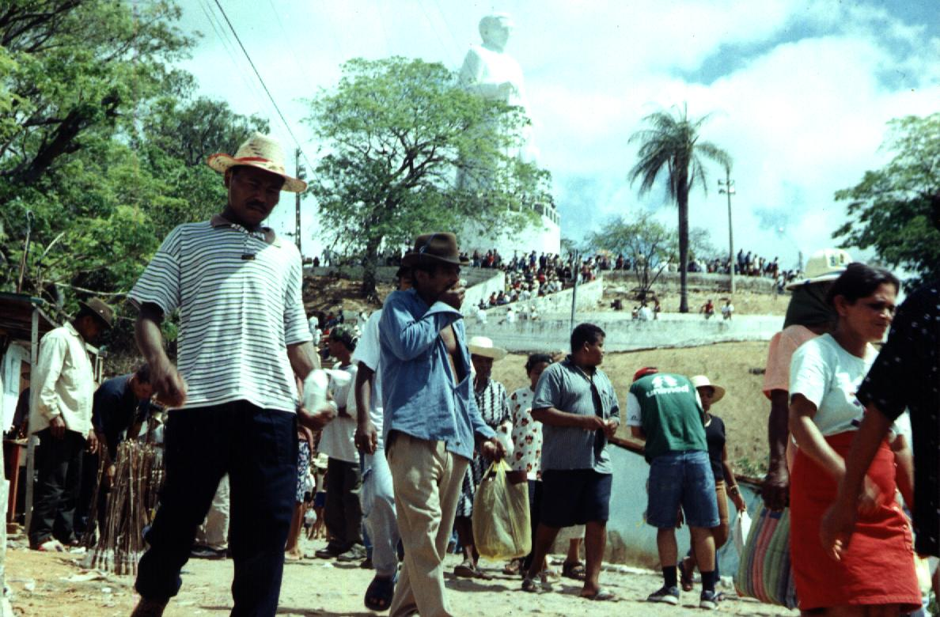
Juazeiro do Norte, the capital of idolatry
“Welcome to the capital of the Faith: Father Cicero – the reason for everything”
“Thank you, Father Cicero…”

Slide 23
FOR THE EVANGELIZATION OF SERTÃO NORDESTINO
Pray...

